Slide 1
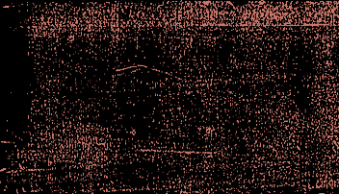

Identifying Infection In Plants Using
Inception V3 On Plant Leaves
Team
Jaydutt Joshi
Keith Frank
Isaac Ayo
Shariq Shaikh
Notes:
Keith

Slide 2
Project Overview
The leaves of a plant can be used to determine the health of the plant
The purpose of this work is to develop a system that can detect and identify types of diseases based on images
The current version supports only a few crops and diseases associated with them, but the dataset can be expanded for the system to identify many more diseases
If a disease is detected then the user shall be provided with a solution to get rid of it
https://github.com/jdscifi/PlantDiseaseIdentification
Notes:
Keith

Slide 3
Data
We have used the Crowd AI Plant Disease Dataset for disease identification.
It has 25 classes across five crops/plants.
It has the combination of healthy and diseased leaves.
Plant | No. of Diseases | Images
Apple | 4 | 3051
Corn | 4 | 3732
Grape | 4 | 3942
Potato | 3 | 2062
Tomato | 10 | 17860
Total | 25 | 30647
Notes:
Keith

Slide 4
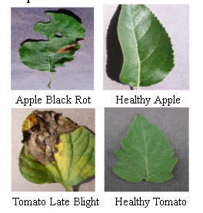
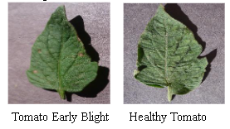
Samples
Images show a clear contrast between healthy and infected plants.
Images shows that its quite enigmatic to recognize whether the leaf is healthy or not.
Notes:
Keith

Slide 5
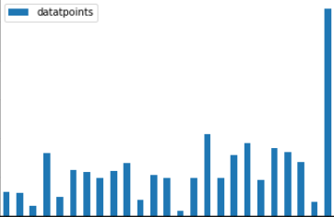
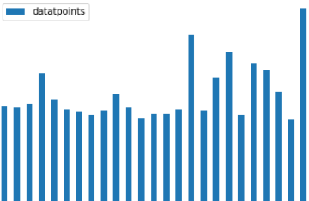
Imbalance
Did over sampling on classes like Potatoes healthy had only 120 images
Notes:
Shariq

Slide 6
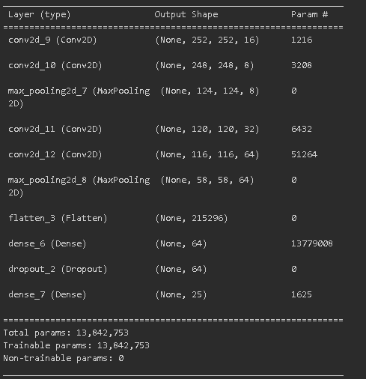
Attempt 1:
We started off by implementing the model pipeline from scratch. We used a sequential CNN model.
We used 4 convolution layers for feature extraction. The pooling layers reduces the resolution of the features to make them robust against distortions.
However, we faced certain problems with the model we developed:
The model was too generalized to the data. A similar crop image with different background would result into wrong predictions.
To rectify these problems, we progressed over to Transfer learning as explained further.
Notes:
Shariq

Slide 7
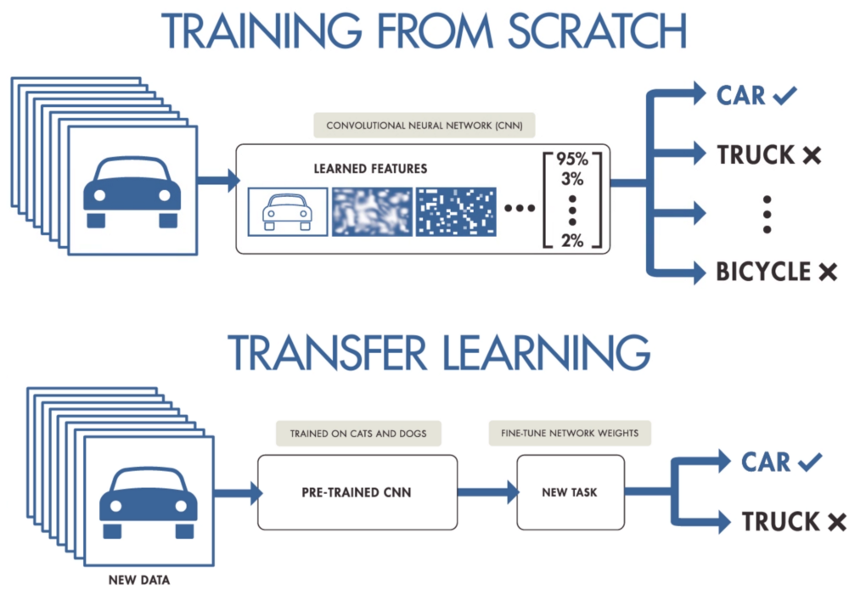
Attempt 2: Transfer Learning
To improve the robustness of our model we decided to implement transfer learning and take advantage of a readily trained network
Transfer Learning for machine Learning is when elements of a pre-trained model are reused in a new machine learning model.
Supposing both models are developed to perform similar tasks, then generalised knowledge can be ‘transferred’ between the two models.
This technique in Machine Learning is good in that it reduces the amount of labelled data and also the resources required to train new models
Notes:
Shariq

Slide 8
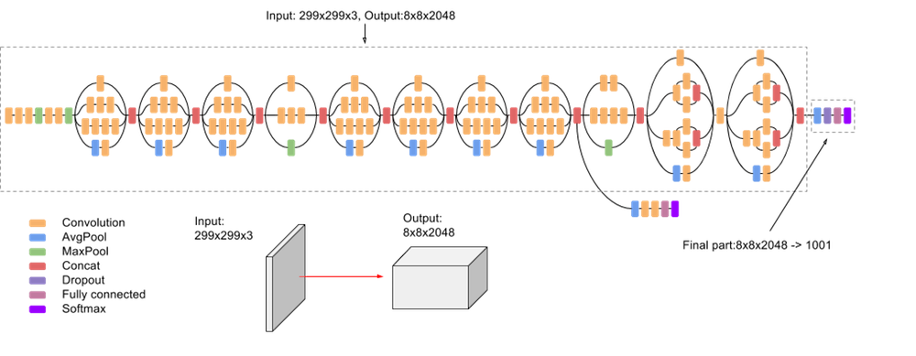
Inception V3
The third edition of Google’s Inception Convolutional Neural Network, Inception V3, was the pre-trained model we considered.
Designed with the intention of allowing deeper networks while also monitoring the number of parameters, to stop from growing too large; it has under 22 million parameters.
Notes:
Isaac
Balances the depth and width of the model
Expected parameters was 24 million
but we reduced because

Slide 9
ImageNet
This is the model we settled on and decided to go with because of the robustness of the network.
The training data is made up of 1000 categories and 1.2 million images, and it has been packaged in a way that allows for easy download.
It is used in training deep convolutional neural networks to learn good general-purpose features.
ImageNet became a fore-runner in the computer vision industry as it addresses the two problems of Object categorization and the need for a large-scale image database
Notes:
Isaac

Slide 10
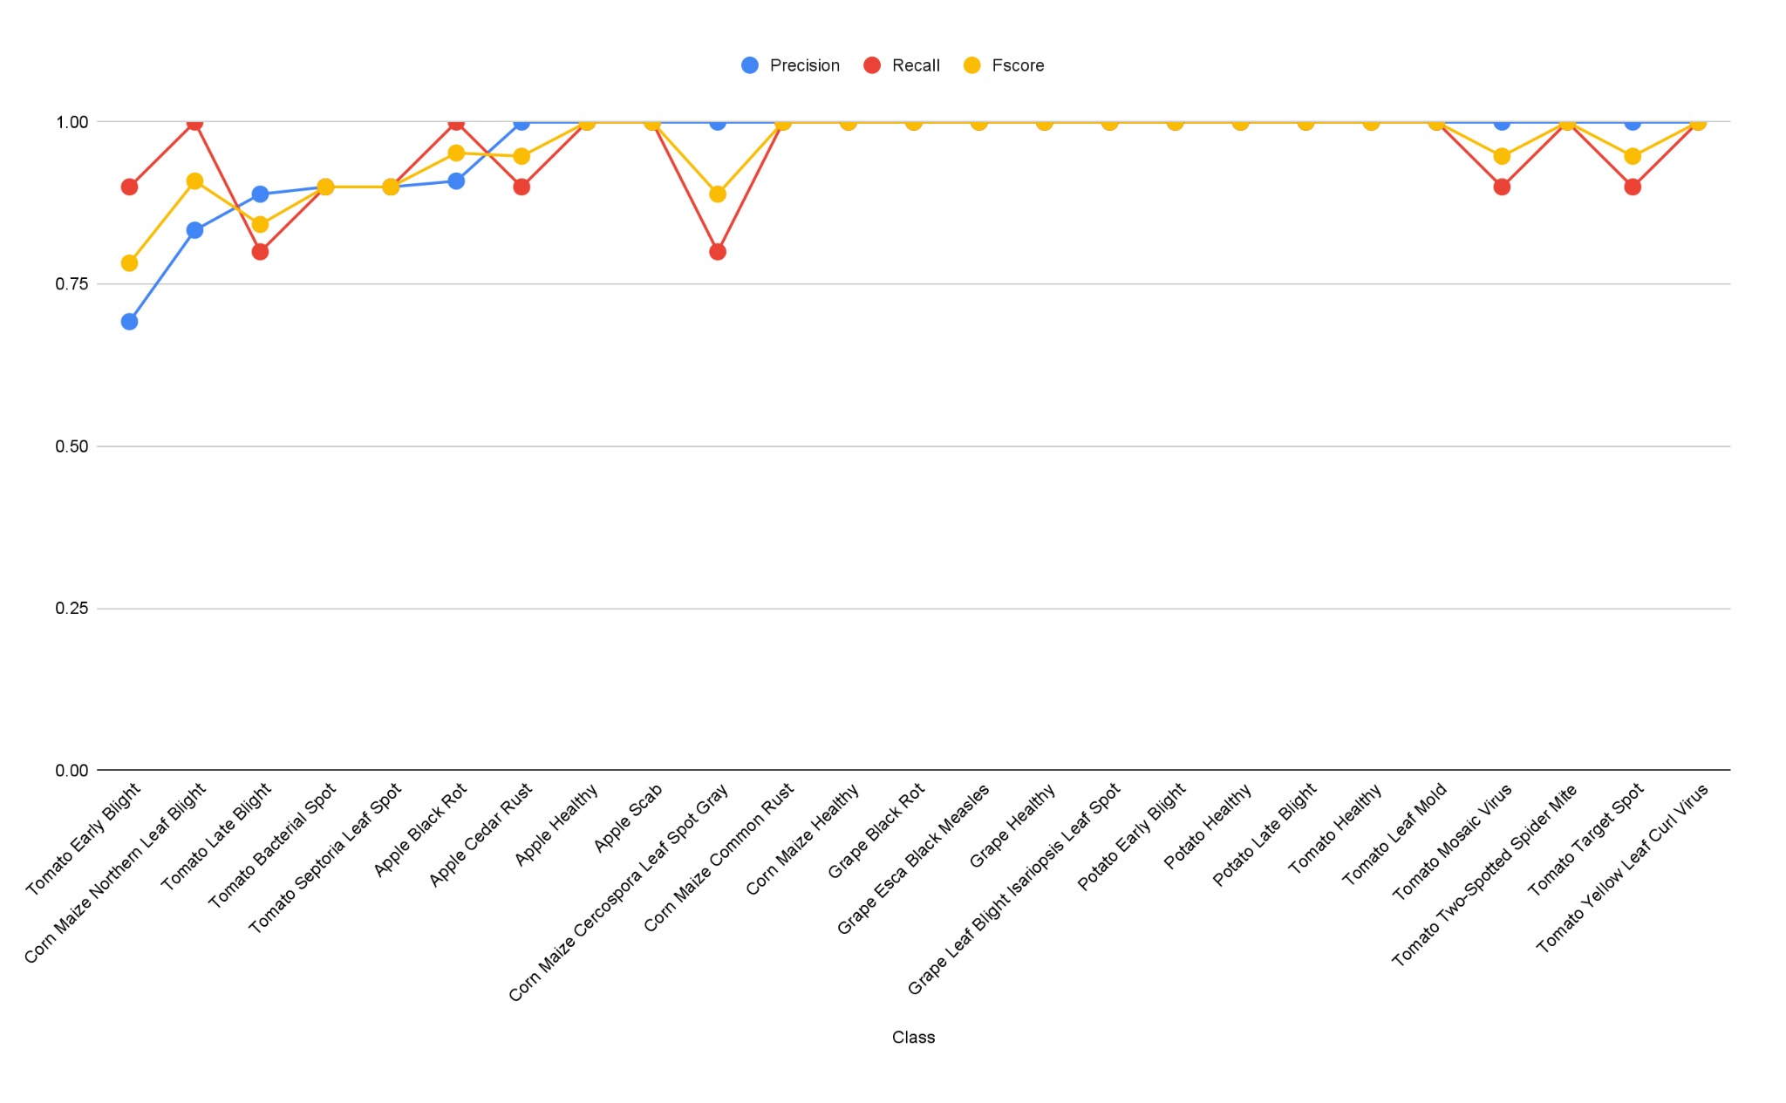
Results
Notes:
JD

Slide 11
Evaluation & Future Scope
Pros
Cons
Great model efficacy
Website support
Simple UI application
Low coverage
We don’t have conclusive infield efficacy
Identification becomes inaccurate when images contain multiple leaves
Future Scope
More Crops & Diseases
Infield Testing
Reinforced Learning
Multi Language Support
Notes:
JD

Slide 12
DEMO
https://cropcounsellor.herokuapp.com/
Notes:
JD

Slide 13
THANK YOU

